Slide 1

Multi-Robot Reinforcement Learning
Mustafa Kağan Aytaç
Fadime Yaren Durmuş

Slide 2
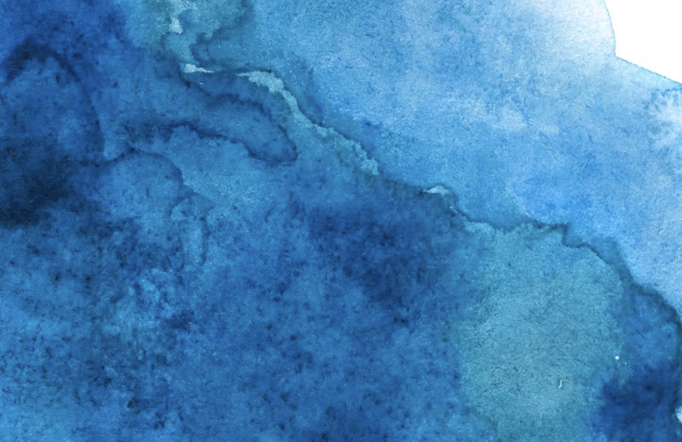
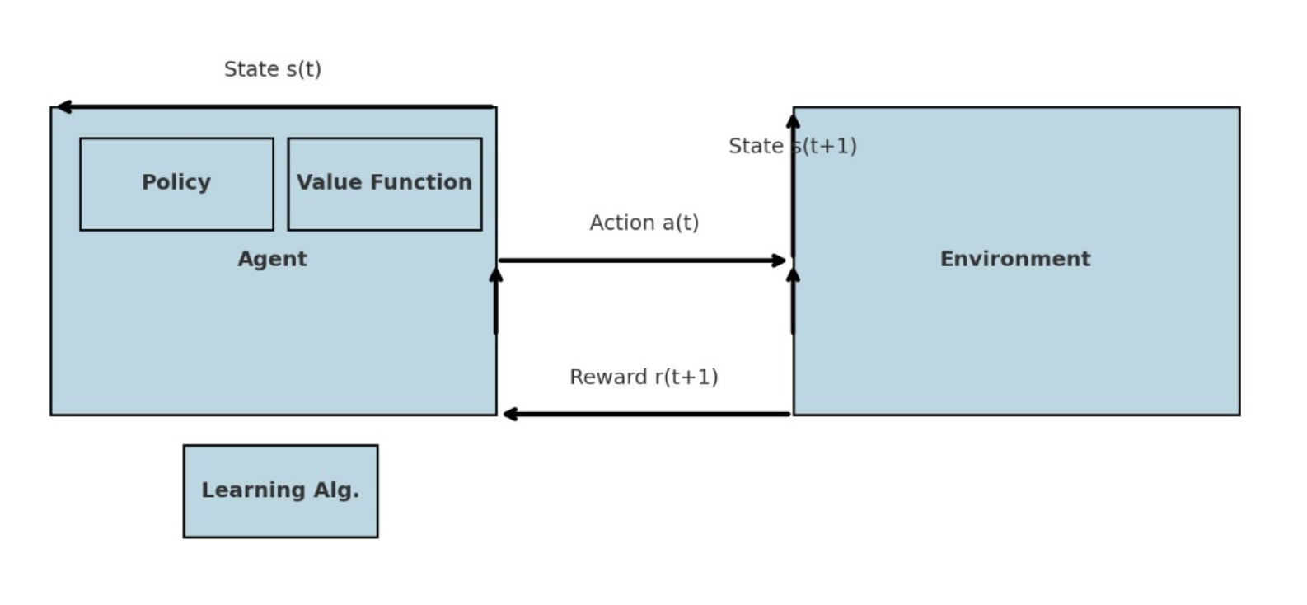

Slide 3
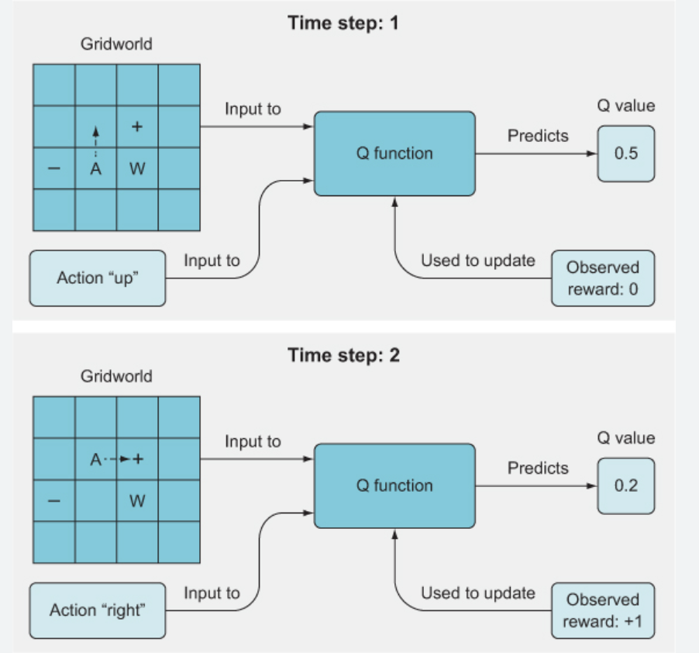
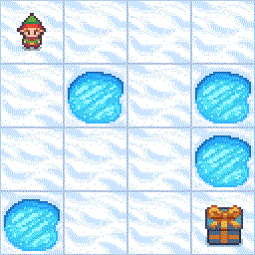

Slide 4
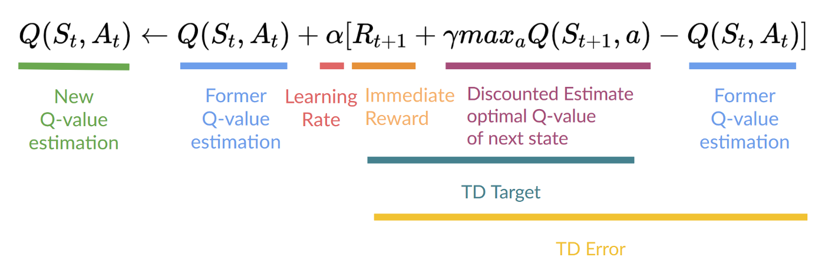
Q-Learning
Q-Table and Q-Values

Slide 5
Q-Table Step by step Explanation

Slide 6
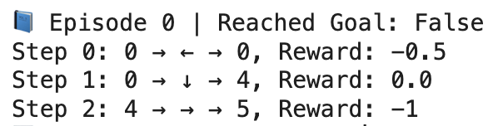
before
States | Left | Bottom | Right | Up
0 | 0 | 0 | 0 | 0
1 | 0 | 0 | 0 | 0
2 | 0 | 0 | 0 | 0
3 | 0 | 0 | 0 | 0
4 | 0 | 0 | 0 | 0
5 | 0 | 0 | 0 | 0
6 | 0 | 0 | 0 | 0
7 | 0 | 0 | 0 | 0
8 | 0 | 0 | 0 | 0
9 | 0 | 0 | 0 | 0
10 | 0 | 0 | 0 | 0
11 | 0 | 0 | 0 | 0
12 | 0 | 0 | 0 | 0
13 | 0 | 0 | 0 | 0
14 | 0 | 0 | 0 | 0
15 | 0 | 0 | 0 | 0
Episode 0
after
States | Left | Bottom | Right | Up
0 | -0.15 | 0 | 0 | 0
1 | 0 | 0 | 0 | 0
2 | 0 | 0 | 0 | 0
3 | 0 | 0 | 0 | 0
4 | 0 | 0 | -0.3 | 0
5 | 0 | 0 | 0 | 0
6 | 0 | 0 | 0 | 0
7 | 0 | 0 | 0 | 0
8 | 0 | 0 | 0 | 0
9 | 0 | 0 | 0 | 0
10 | 0 | 0 | 0 | 0
11 | 0 | 0 | 0 | 0
12 | 0 | 0 | 0 | 0
13 | 0 | 0 | 0 | 0
14 | 0 | 0 | 0 | 0
15 | 0 | 0 | 0 | 0
0 → 0 → 4→ 5
States
0. 1. 2. 3.
4. 5. 6. 7.
8. 9. 10. 11
12 13 14 15

Slide 7

Q(0,←)=0+0.3×(−0.5−0)=−0.15
Q(0,↓)=0+0.3×(0+0−0)=0
Q(4,→)=0+0.3×(−1−0)=−0.3

Slide 8
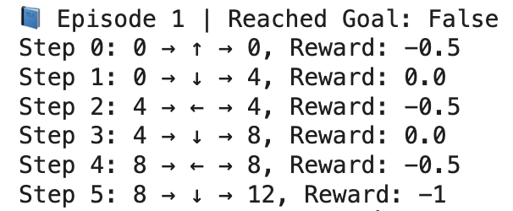
before
States | Left | Bottom | Right | Up
0 | -0.15 | 0 | 0 | 0
1 | 0 | 0 | 0 | 0
2 | 0 | 0 | 0 | 0
3 | 0 | 0 | 0 | 0
4 | 0 | 0 | -0.3 | 0
5 | 0 | 0 | 0 | 0
6 | 0 | 0 | 0 | 0
7 | 0 | 0 | 0 | 0
8 | 0 | 0 | 0 | 0
9 | 0 | 0 | 0 | 0
10 | 0 | 0 | 0 | 0
11 | 0 | 0 | 0 | 0
12 | 0 | 0 | 0 | 0
13 | 0 | 0 | 0 | 0
14 | 0 | 0 | 0 | 0
15 | 0 | 0 | 0 | 0
Episode 1
after
States | Left | Bottom | Right | Up
0 | -0.15 | 0 | 0 | -0.15
1 | 0 | 0 | 0 | 0
2 | 0 | 0 | 0 | 0
3 | 0 | 0 | 0 | 0
4 | -0.15 | 0 | -0.3 | 0
5 | 0 | 0 | 0 | 0
6 | 0 | 0 | 0 | 0
7 | 0 | 0 | 0 | 0
8 | -0.15 | -0.3 | 0 | 0
9 | 0 | 0 | 0 | 0
10 | 0 | 0 | 0 | 0
11 | 0 | 0 | 0 | 0
12 | 0 | 0 | 0 | 0
13 | 0 | 0 | 0 | 0
14 | 0 | 0 | 0 | 0
15 | 0 | 0 | 0 | 0
States
0. 1. 2. 3.
4. 5. 6. 7.
8. 9. 10. 11
12 13 14 15

Slide 9
Q(0,↑)=0+0.3⋅(−0.5−0)=−0.15
Q(0,↓)=0+0.3⋅(0+0.99⋅max(Q(4))−0)=0
Q(4,←)=0+0.3⋅(−0.5−0)=−0.15
Q(4,↓)=0+0.3⋅(0+0.99⋅max(Q(8))−0)=0
Q(8,→)=0+0.3⋅(−0.5−0)=−0.15
Q(8,↓)=0+0.3⋅(−1−0)=−0.3

Slide 10
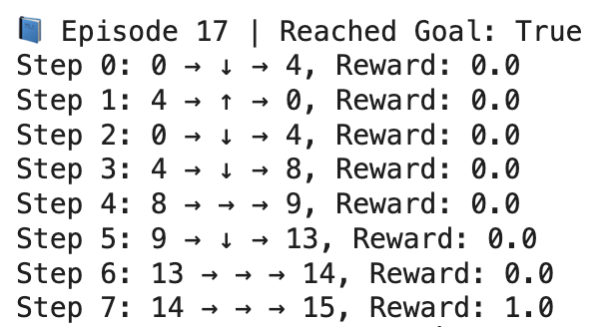
before
 | ← | ↓ | → | ↑
0 | -0.42 | 0.00 | 0.00 | -0.15
1 | 0.00 | 0.00 | 0.00 | 0.00
2 | 0.00 | 0.00 | 0.00 | 0.00
3 | 0.00 | 0.00 | 0.00 | 0.00
4 | -0.42 | 0.00 | -0.83 | 0.00
5 | 0.00 | 0.00 | 0.00 | 0.00
6 | -0.30 | 0.00 | 0.00 | 0.00
7 | 0.00 | 0.00 | 0.00 | 0.00
8 | -0.38 | -0.88 | 0.00 | 0.00
9 | 0.00 | 0.00 | 0.00 | -0.51
10 | 0.00 | 0.00 | -0.30 | 0.00
11 | 0.00 | 0.00 | 0.00 | 0.00
12 | 0.00 | 0.00 | 0.00 | 0.00
13 | -0.51 | -0.15 | 0.00 | 0.00
14 | 0.00 | 0.00 | 0.00 | 0.00
15 | 0.00 | 0.00 | 0.00 | 0.00
Episode 17
after
 | ← | ↓ | → | ↑
0 | -0.42 | 0.00 | 0.00 | -0.15
1 | 0.00 | 0.00 | 0.00 | 0.00
2 | 0.00 | 0.00 | 0.00 | 0.00
3 | 0.00 | 0.00 | 0.00 | 0.00
4 | -0.42 | 0.00 | -0.83 | 0.00
5 | 0.00 | 0.00 | 0.00 | 0.00
6 | -0.30 | 0.00 | 0.00 | 0.00
7 | 0.00 | 0.00 | 0.00 | 0.00
8 | -0.38 | -0.88 | 0.00 | 0.00
9 | 0.00 | 0.00 | 0.00 | -0.51
10 | 0.00 | 0.00 | -0.30 | 0.00
11 | 0.00 | 0.00 | 0.00 | 0.00
12 | 0.00 | 0.00 | 0.00 | 0.00
13 | -0.51 | -0.15 | 0.00 | 0.00
14 | 0.00 | 0.00 | 0.30 | 0.00
15 | 0.00 | 0.00 | 0.00 | 0.00
States
0. 1. 2. 3.
4. 5. 6. 7.
8. 9. 10. 11
12 13 14 15

Slide 11
Q(0,↓)=0+0.3×(0+0.99×max(Q(4))−0)=0
Q(4,↑)=0+0.3×(0+0.99×max(Q(0))−0)=0
Q(0,↓)=0+0.3×(0+0.99×max(Q(4))−0)=0
Q(4,↓)=0+0.3×(0+0.99×max(Q(8))−0)=0
Q(8,→)=0+0.3×(0+0.99×max(Q(9))−0)=0
Q(9,↓)=0+0.3×(0+0.99×max(Q(13))−0)=0
Q(13,→)=0+0.3×(0+0.99×max(Q(14))−0)=0
Q(14,→)=0+0.3×(1+0.99×max(Q(15))−0)=0.3

Slide 12
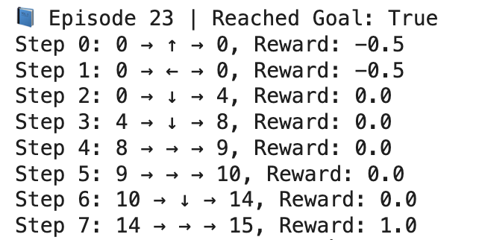
before
 | ← | ↓ | → | ↑
0 | -0.46 | 0.00 | 0.00 | -0.26
1 | 0.00 | 0.00 | 0.00 | 0.00
2 | 0.00 | 0.00 | 0.00 | 0.00
3 | 0.00 | 0.00 | 0.00 | 0.00
4 | -0.42 | 0.00 | -0.94 | 0.00
5 | 0.00 | 0.00 | 0.00 | 0.00
6 | -0.30 | 0.00 | 0.00 | 0.00
7 | 0.00 | 0.00 | 0.00 | 0.00
8 | -0.47 | -0.94 | 0.00 | 0.00
9 | 0.00 | 0.00 | 0.00 | -0.51
10 | 0.00 | 0.00 | -0.30 | 0.00
11 | 0.00 | 0.00 | 0.00 | 0.00
12 | 0.00 | 0.00 | 0.00 | 0.00
13 | -0.51 | -0.15 | 0.00 | 0.00
14 | 0.00 | 0.00 | 0.30 | 0.00
15 | 0.00 | 0.00 | 0.00 | 0.00
Episode 23
after
 | ← | ↓ | → | ↑
0 | -0.47 | 0.00 | 0.00 | -0.33
1 | 0.00 | 0.00 | 0.00 | 0.00
2 | 0.00 | 0.00 | 0.00 | 0.00
3 | 0.00 | 0.00 | 0.00 | 0.00
4 | -0.42 | 0.00 | -0.94 | 0.00
5 | 0.00 | 0.00 | 0.00 | 0.00
6 | -0.30 | 0.00 | 0.00 | 0.00
7 | 0.00 | 0.00 | 0.00 | 0.00
8 | -0.47 | -0.94 | 0.00 | 0.00
9 | 0.00 | 0.00 | 0.00 | -0.51
10 | 0.00 | 0.09 | -0.30 | 0.00
11 | 0.00 | 0.00 | 0.00 | 0.00
12 | 0.00 | 0.00 | 0.00 | 0.00
13 | -0.51 | -0.15 | 0.00 | 0.00
14 | 0.00 | 0.00 | 0.51 | 0.00
15 | 0.00 | 0.00 | 0.00 | 0.00
States
0. 1. 2. 3.
4. 5. 6. 7.
8. 9. 10. 11
12 13 14 15

Slide 13
Q(0,↑)=−0.26+0.3×(−0.5+0.99×max(Q(0))−(−0.26)) than
Q(0,↑)=−0.26+0.3×(−0.5+0−(−0.26))=−0.26+0.3×(−0.24)= −0.33
Q(0,←)=−0.46+0.3×(−0.5+0.99×max(Q(0))−(−0.46)) than
Q(0,←)=−0.46+0.3×(−0.5+0−(−0.46))=−0.46+0.3×(−0.04)=−0.47​
Q(0,↓)=0+0.3×(0+0.99×max(Q(4))−0) than max(Q(4))=max(−0.42,0,−0.94,0)=0 than
Q(0,↓)=0+0.3×(0+0−0)=0​
Q(4,↓)=0+0.3×(0+0.99×max(Q(8))−0) than max(Q(8))=max(−0.47,−0.94,0,0)=0 than Q(4,↓)=0​
Q(8,→)=0+0.3×(0+0.99×max(Q(9))−0) than max(Q(9))=max(0,0,0,−0.51)=0 than Q(8,→)=0​
Q(9,→)=0+0.3×(0+0.99×max(Q(10))−0) than max(Q(10))=max(0,0,−0.30,0)=0 than Q(9,→)=0
Q(10,↓)=0+0.3×(0+0.99×max(Q(14))−0) than max(Q(14))=max(0,0,0.30,0)=0.30 than
Q(10,↓)=0.3×(0.99×0.30)=0.3×0.297=0.09​
Q(14,→)=0.30+0.3×(1+0.99×max(Q(15))−0.30) than max(Q(15))=0 than
Q(14,→)=0.30+0.3×(1−0.30)=0.30+0.21= 0.51
​

Slide 14
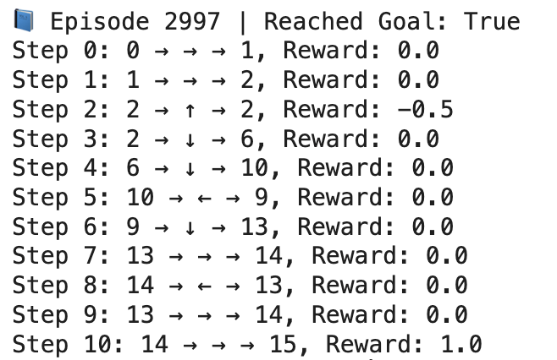
before
 | ← | ↓ | → | ↑
0 | 0.44 | 0.95 | 0.95 | 0.44
1 | 0.94 | -1.00 | 0.96 | 0.45
2 | 0.95 | 0.97 | 0.95 | 0.46
3 | 0.96 | -0.99 | 0.45 | 0.45
4 | 0.45 | 0.96 | -1.00 | 0.94
5 | 0.00 | 0.00 | 0.00 | 0.00
6 | -1.00 | 0.98 | -1.00 | 0.96
7 | 0.00 | 0.00 | 0.00 | 0.00
8 | 0.46 | -1.00 | 0.97 | 0.95
9 | 0.96 | 0.98 | 0.98 | -1.00
10 | 0.97 | 0.99 | -1.00 | 0.97
11 | 0.00 | 0.00 | 0.00 | 0.00
12 | 0.00 | 0.00 | 0.00 | 0.00
13 | -1.00 | 0.48 | 0.99 | 0.97
14 | 0.98 | 0.49 | 1.00 | 0.98
15 | 0.00 | 0.00 | 0.00 | 0.00
Episode 2997
after
 | ← | ↓ | → | ↑
0 | 0.44 | 0.95 | 0.95 | 0.44
1 | 0.94 | -1.00 | 0.96 | 0.45
2 | 0.95 | 0.97 | 0.95 | 0.46
3 | 0.96 | -0.99 | 0.45 | 0.45
4 | 0.45 | 0.96 | -1.00 | 0.94
5 | 0.00 | 0.00 | 0.00 | 0.00
6 | -1.00 | 0.98 | -1.00 | 0.96
7 | 0.00 | 0.00 | 0.00 | 0.00
8 | 0.46 | -1.00 | 0.97 | 0.95
9 | 0.96 | 0.98 | 0.98 | -1.00
10 | 0.97 | 0.99 | -1.00 | 0.97
11 | 0.00 | 0.00 | 0.00 | 0.00
12 | 0.00 | 0.00 | 0.00 | 0.00
13 | -1.00 | 0.48 | 0.99 | 0.97
14 | 0.98 | 0.49 | 1.00 | 0.98
15 | 0.00 | 0.00 | 0.00 | 0.00
States
0. 1. 2. 3.
4. 5. 6. 7.
8. 9. 10. 11
12 13 14 15

Slide 15
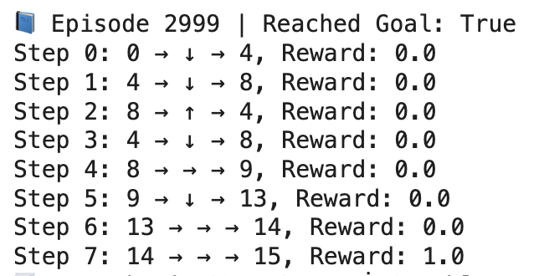
before
 | ← | ↓ | → | ↑
0 | 0.44 | 0.95 | 0.95 | 0.44
1 | 0.94 | -1.00 | 0.96 | 0.45
2 | 0.95 | 0.97 | 0.95 | 0.46
3 | 0.96 | -0.99 | 0.45 | 0.45
4 | 0.45 | 0.96 | -1.00 | 0.94
5 | 0.00 | 0.00 | 0.00 | 0.00
6 | -1.00 | 0.98 | -1.00 | 0.96
7 | 0.00 | 0.00 | 0.00 | 0.00
8 | 0.46 | -1.00 | 0.97 | 0.95
9 | 0.96 | 0.98 | 0.98 | -1.00
10 | 0.97 | 0.99 | -1.00 | 0.97
11 | 0.00 | 0.00 | 0.00 | 0.00
12 | 0.00 | 0.00 | 0.00 | 0.00
13 | -1.00 | 0.48 | 0.99 | 0.97
14 | 0.98 | 0.49 | 1.00 | 0.98
15 | 0.00 | 0.00 | 0.00 | 0.00
Episode 2999
after
State | ← | ↓ | → | ↑
0 | 0.44 | 0.95 | 0.95 | 0.44
1 | 0.94 | -1.00 | 0.96 | 0.45
2 | 0.95 | 0.97 | 0.95 | 0.46
3 | 0.96 | -0.99 | 0.45 | 0.45
4 | 0.45 | 0.96 | -1.00 | 0.94
5 | 0.00 | 0.00 | 0.00 | 0.00
6 | -1.00 | 0.98 | -1.00 | 0.96
7 | 0.00 | 0.00 | 0.00 | 0.00
8 | 0.46 | -1.00 | 0.97 | 0.95
9 | 0.96 | 0.98 | 0.98 | -1.00
10 | 0.97 | 0.99 | -1.00 | 0.97
11 | 0.00 | 0.00 | 0.00 | 0.00
12 | 0.00 | 0.00 | 0.00 | 0.00
13 | -1.00 | 0.48 | 0.99 | 0.97
14 | 0.98 | 0.49 | 1.00 | 0.98
15 | 0.00 | 0.00 | 0.00 | 0.00
0 → 1 → 2 → 6 → 10 → 14 → 15
States
0. 1. 2. 3.
4. 5. 6. 7.
8. 9. 10. 11
12 13 14 15

Slide 16
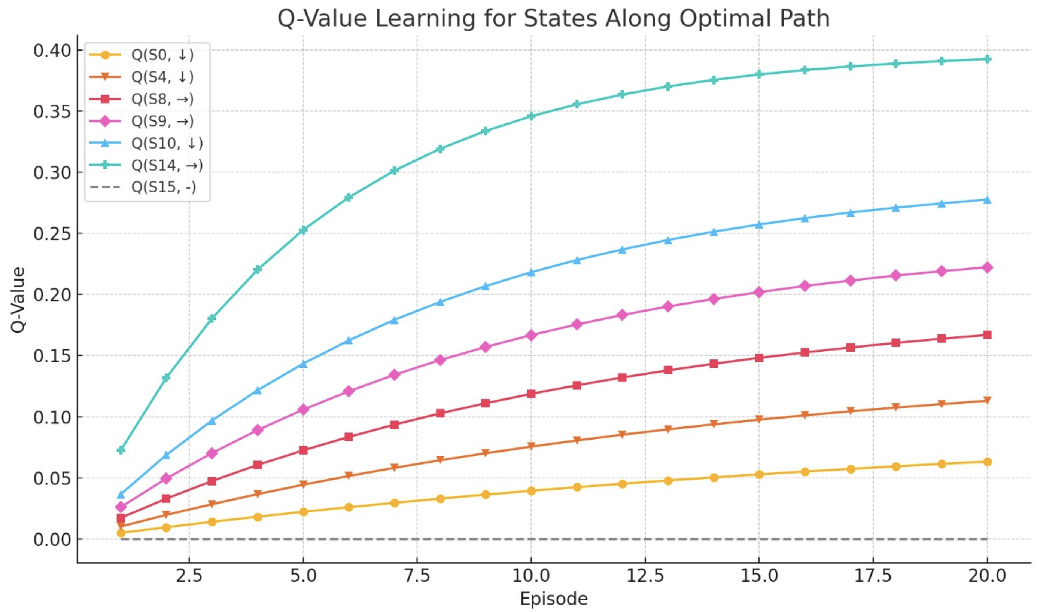

Slide 17
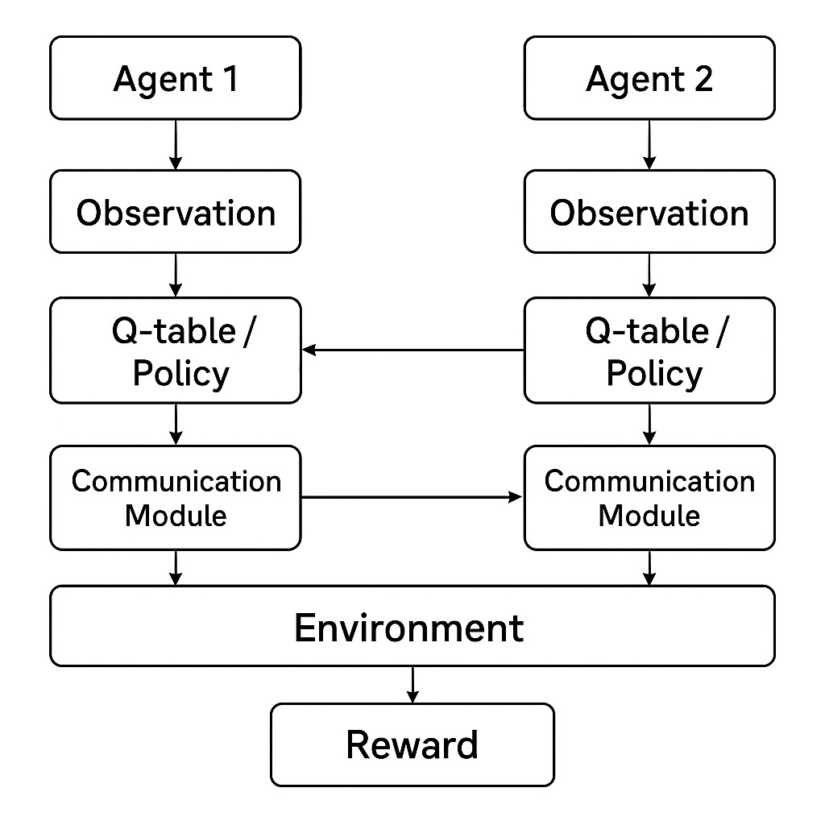

Slide 18
Thank You For Listening To Us

